Slide 1

Next Generation Academic Planner (Next Gen AP)
Getting Started: Creating an academic plan

Slide 2
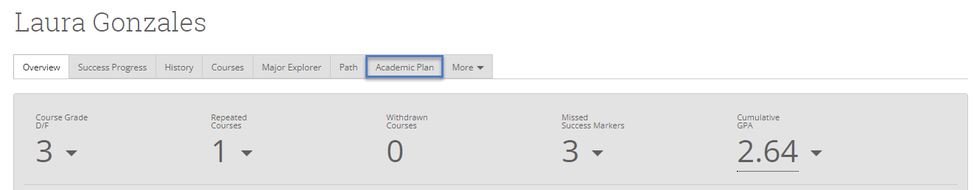
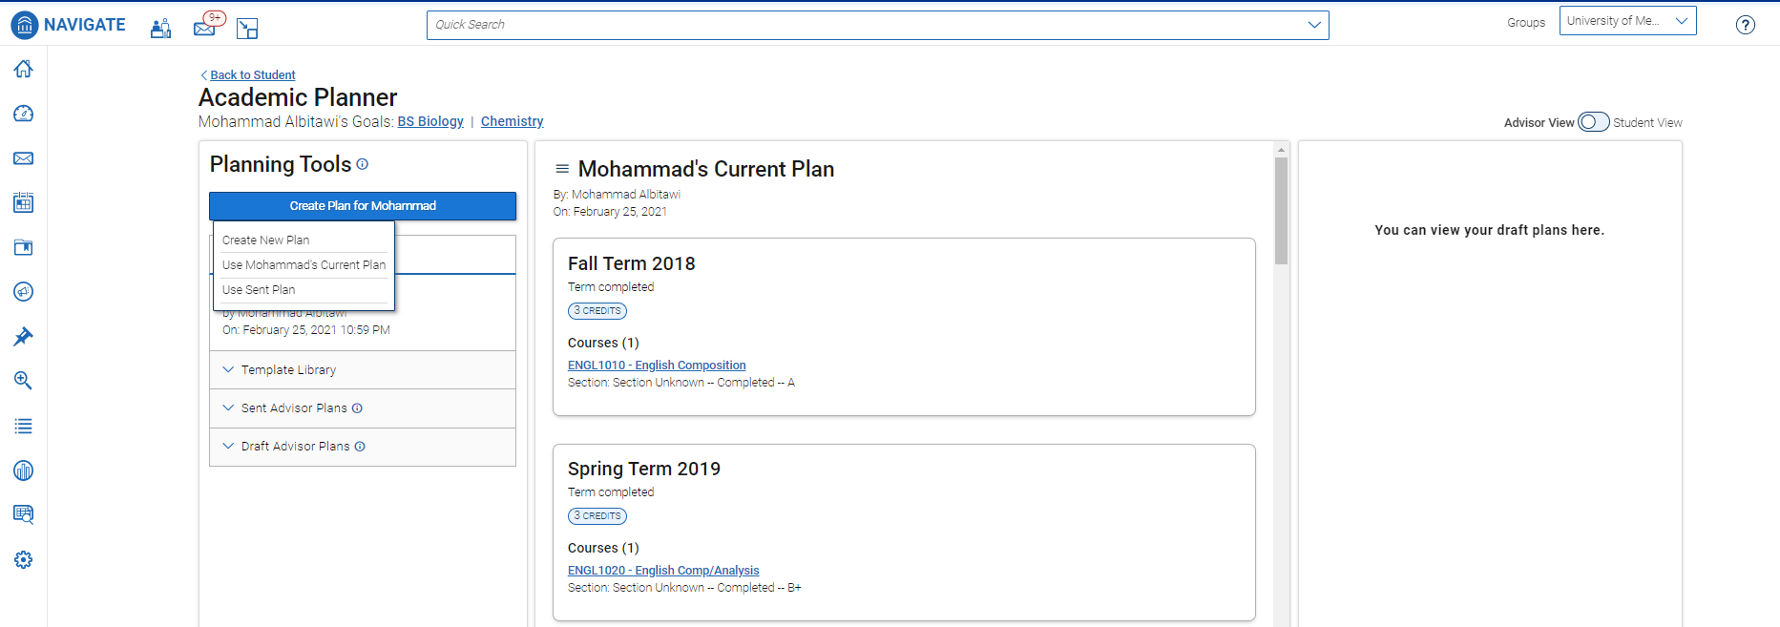
Getting Started: Creating a plan
Use the Quick Search or Advanced Search to find a student profile. Select the Academic Plan tab.
Click the Create Plan button in the upper left-hand corner to create a plan for the student. Select Create New Plan

Slide 3
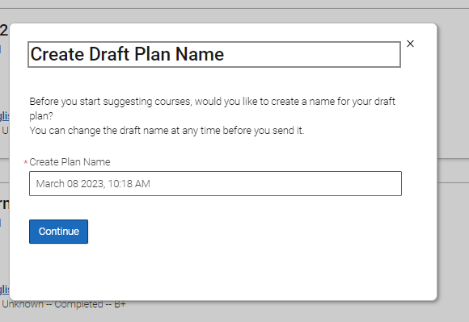
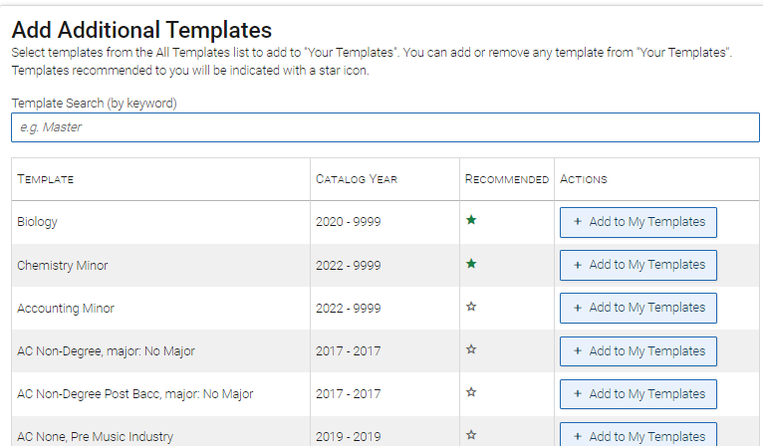
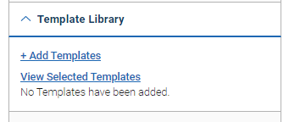
Getting Started: Creating a plan
Give the plan a name that is descriptive for students, including terms and goals, if applicable.
Click Template Library and then + Add Templates to browse available templates. Templates with a Recommended star match the student’s declared academic program(s).
Select Add to My Templates

Slide 4
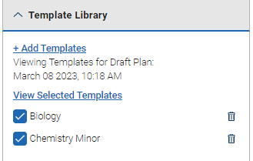
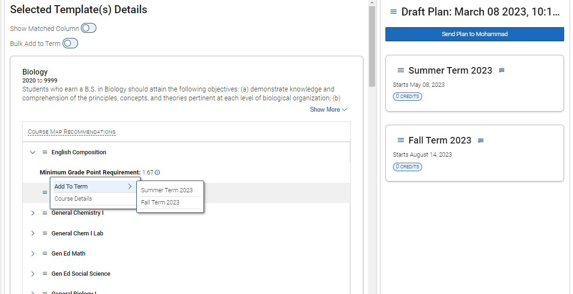
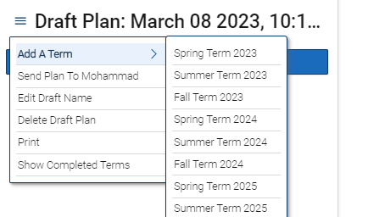
Getting Started: Creating a plan
Select the template(s) you wish to view and click View Selected Templates
From the Menu next to Draft Plan (upper right-hand side) select Add A Term and then select terms to add to the plan
Use the menu next to each course to select Add to Term

Slide 5
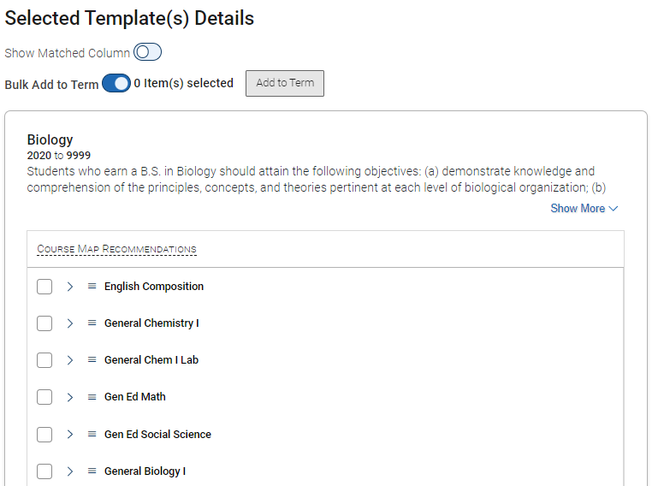
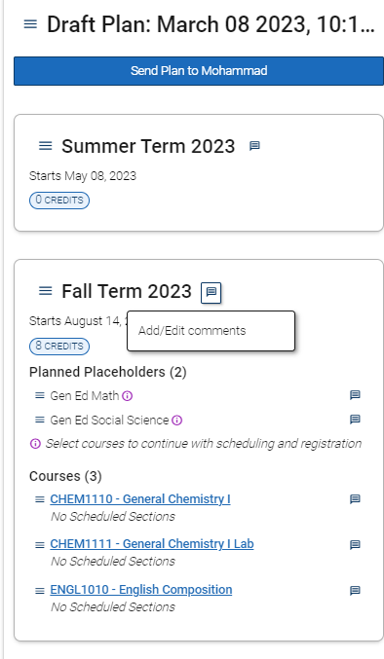
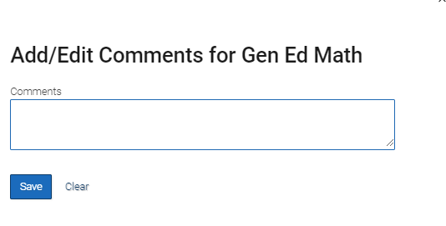
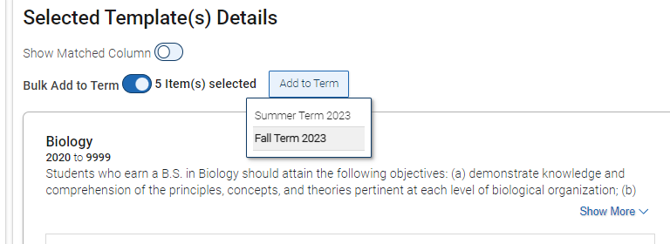
Getting Started: Creating a plan
To add multiple courses at once, click the Bulk Add to Term toggle
Select the courses to add, then click the Add To Term button and select the appropriate term
Use the Add/Edit comments icon next to the term, placeholder, or course to leave notes

Slide 6
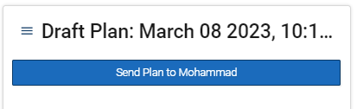
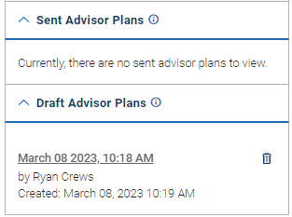
Getting Started: Creating a plan
When complete, use the Send Plan to button to send the plan to the student
Unsent plans will remain in the Draft Advisor Plans section until sent. All sent plans will be saved in the Sent Advisor Plans section

Slide 7
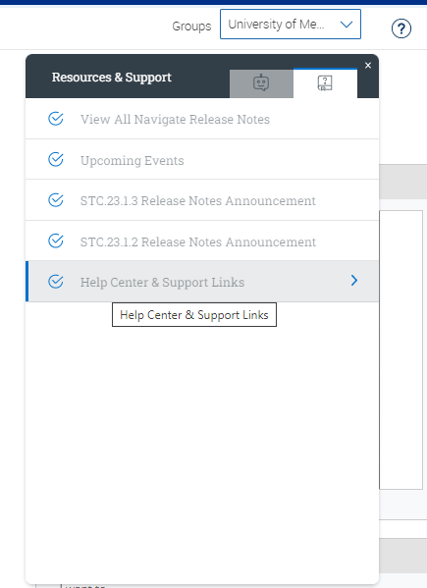
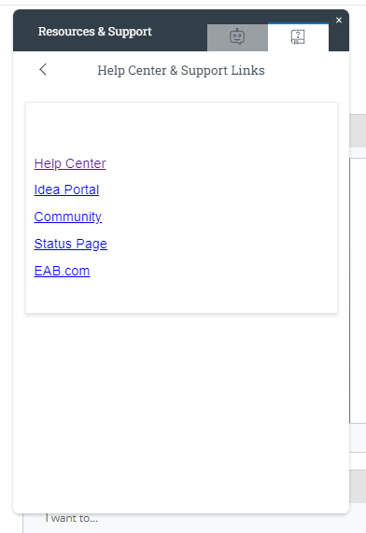
Resources
(Help Center) Reviewing an Academic Plan in Next Generation Academic Planning
(Help Center)Academic Planner for Students
***To access Help Center resources***
Login to Navigate
Access Help Center
Click the ? Icon in the upper right corner of the screen
Click Help Center & Support Links
Click Help Center
Click links below

