Slide 1

How to Get to the Finish Line

Slide 2
Graduation Analyst
My job is to make sure you have everything you need to graduate. Courses, credits, transfer credits, forms etc.
If you are planning to write a Thesis or Dissertation – I will be the last person to approve.
Commencement Program – I assist the Commencement office in putting the program together for all Masters and Doctoral students.
I will be at Graduation to assist and distribute diplomas.
I am always here to help

Slide 3
Steps Needed to Apply for Graduation
Deadlines – have an idea of what term you might graduate – look up the deadline and make a note
Masters and PHD – Candidacy Form
Certificates – Review UmDegree
File for Graduation

Slide 4
Applying To Graduate – Step 1
Logon to myMemphis – on the UofM Website
Student Pages
My Degree
Commencement and Graduation on the Right
1

Slide 5
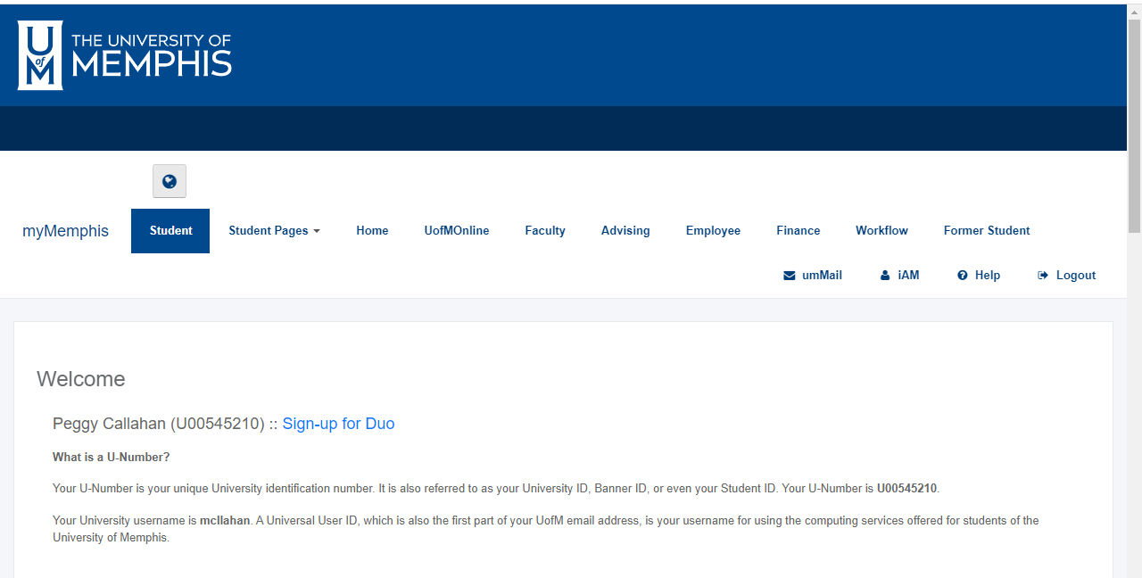
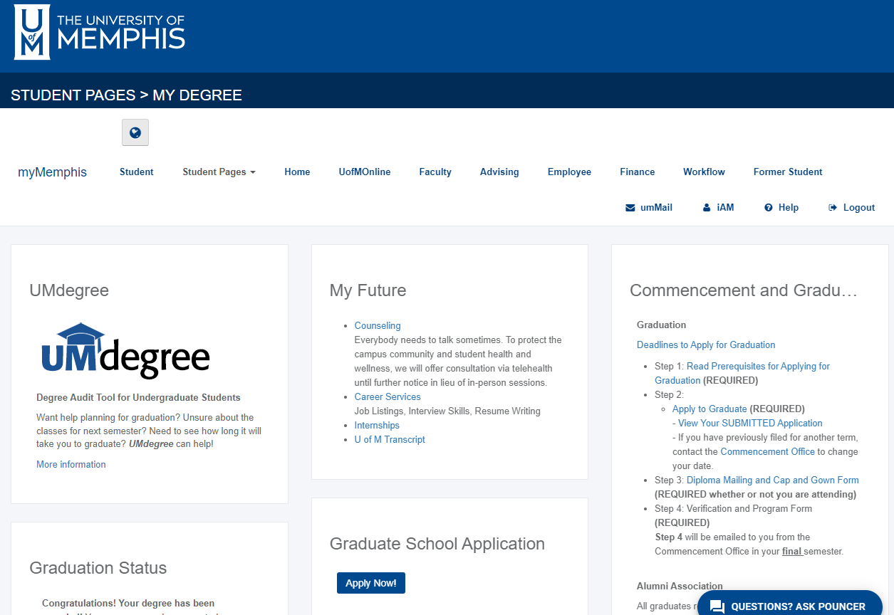

Slide 6
Step One - Notes
Found on MyMemphis – Student Tab – Commencement
You must apply to graduate for each degree you plan to receive – Certificate, Mastes and/or PhD.
You must select your degree program on the Graduation Application. If you do not see your program listed, contact the Graduate School.
Common Errors in completing the graduation application
Applied Previously
GPA is below 3.0
The Certificate or Masters you think your pursing along with your PHD is not included in your degree plan. Review you Transcript and make sure you are enrolled in all the degrees you plan to pursue.

Slide 7
Applying To Graduate – Step 2
Step 2 – Review the Graduate School Graduation Information
Deadlines
Transcripts – have you taken everything
2

Slide 8
Step 2 –Candidacy forms/UMDegree
Masters and PHD
Complete a Candidacy form - Print a copy of the transcript – you will need a list of all the courses required for the degree. Those you are currently taking the grade will be an IP – in progress. Link to access - https://www.memphis.edu/gradschool/current_students/graduation.php
Certificate Students
Review UMDegree to make sure you have taken everything

Slide 9
Step #2 – Candidacy Form Common Errors on Candidacy Forms
Not listing all classes required for your degree. Electives does not mean Optional!
Incorrect hours and grades. For current semester courses either list “IP” as the grade or leave it blank.
Incorrect degree or concentration
Filling out multiple forms – please don’t this causes confusion.
Listing courses not on your transcript (transfer credits, credit by exam, etc)
Please list all PREVIOUS Degrees – example – BS, 2017, Stanford University

Slide 10
General Information
Keep a copy of your signed Candidacy form
Check your MyMemphis – Student tab for confirmation you are Graduating.
The next step – Commencement will send emails regarding the next steps.
Review the Printed Program – the Commencement Office will be sending out two Proofs – please take the time to review. Make sure everything is spelled correctly and you are listed in the correct College and Degree. Mistakes do happen

Slide 11
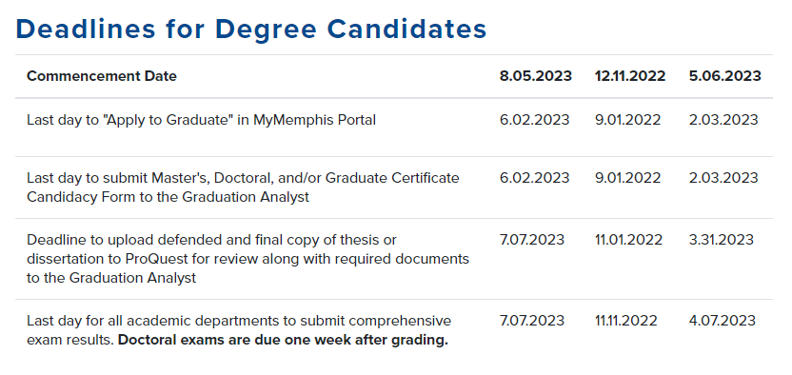
Deadlines for Degree Candidates

Slide 12
Thesis/Dissertation Progression
Task |  | Form
Form your Dissertation Committee |  | Faculty Committee Appointment Form
Take Comprehensive Exams |  | Comprehensive Exam Results Form
Defend your proposal or prospectus |  | Dissertation Proposal Defense Form
Defend your dissertation |  | Dissertation Checklist Final ETD Approval Form Final Defense Results Form
All completed forms should be forwarded to Graduate Analyst - gsgraduateanalyst@memphis.edu

Slide 13
Thesis/Dissertation - Forms
The Graduate School has lots of forms – search the UofM website – GRADUATE SCHOOL FORMS – these forms have been set up in Etrieve Softdocs. The forms will automatically route to the correct people.
For Thesis & Dissertations
Thesis/Dissertation Checklist
Thesis/Dissertation Faculty Committee Form
Thesis/Dissertation "Proposal" Defense Form
Thesis/Dissertation ETD Approval Form
Thesis/Dissertation "Final" Defense Results Form
In the end all forms must be approved and sent to the Gradaute Analyst. KEEP A COPY for yourself.

Slide 14
Thesis/Dissertation Guide
https://www.memphis.edu/gradschool/current_students/td-prep.php

Slide 15
Formating
The formatting of the T/D is very important. BUT there are lots of resources. Thesis/Dissertation Preparation Guide – found on the UofM website.
Extra spaces between paragraphs
Improper margins
Incorrect graduation date on the title page
Table of contents errors – improper alignment, improper listing
Not numbering mathematical equations
Uploading forms with your T/D. Forms are sent to me – don’t attach.

Slide 16
Next Step
Defended and Final Copies:
Thesis and Dissertations are submitted to ProQuest – the link is #7 of the Guide
The Graduate School will review – looking at formatting. If there are any corrections an email will be sent. Correct and resubmit.
Then the final Thesis/Dissertation will be Delivered to ProQuest.

Slide 17
Thesis/Dissertation Review
Student Defends
Student makes any corrections the committee recommends
Student upload defended Thesis /Dissertation to ProQuest by the deadline
Graduate School reviews for formatting and sends any needed corrections to the student
Student makes corrections and resubmits to ProQuest by the deadline
Thesis/Dissertation is approved

Slide 18
Recommendations & Notes
#1 – Review the deadlines for the term you plan to graduate. Make sure you have given yourself enough time to meet the deadlines. Don’t schedule your Final Defense for two weeks before Graduation – that really doesn’t work.
Give yourself time between your Defense and the Graduate School submission deadline
Keep in mind the time it takes your chair/committee to send feedback
Format your dissertation as soon as possible
Review the formatting guide
The Dissertation/Thesis you submit to ProQuest – is the FINAL version.

Slide 19

Certificates
A Certificate is a Degree in a specific subject – which can be similar or a part of the major
It is a separate degree and needs to be added to your degree program – to add use the Program Update Form
Apply separately from the Masters/PhD.
Candidacy Form – NEW PROCESS
Certificate programs are visible in the UMDegree – The Graduation Analyst will review UMDegree to determine if you are eligible for graduation.
Find UMDegree on Student Pages / My Degree

Slide 20
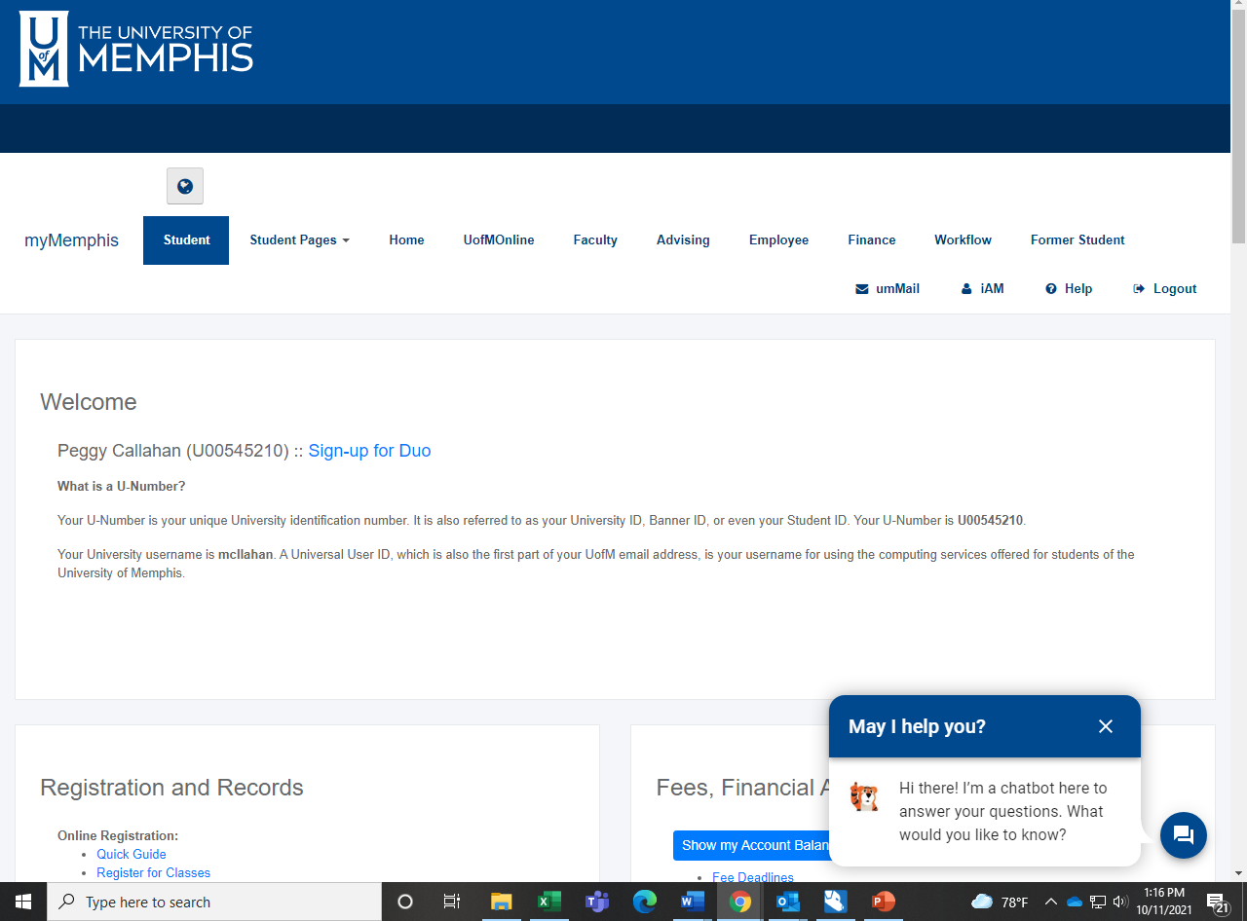
Where to find Information

Slide 21
Student Tab Information
Registration Status
Class Schedule
Graduation Status
Transcripts
Student Profile

Slide 22
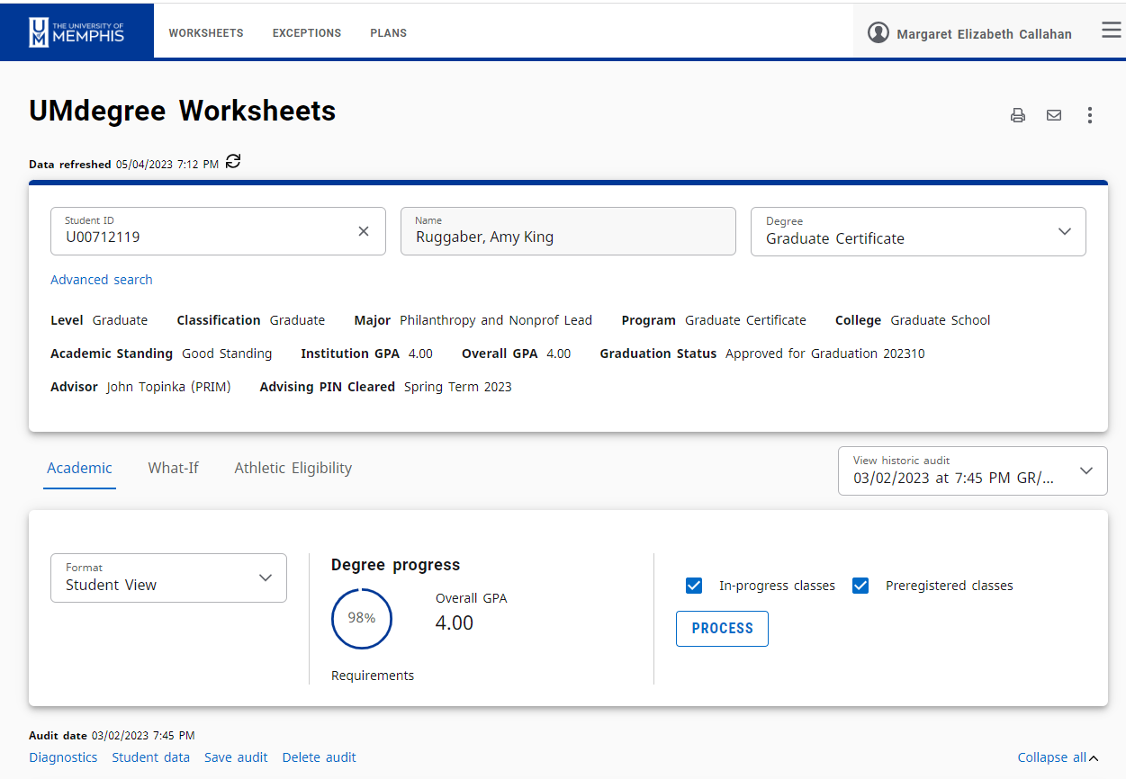
UMDegree
If you do not see the Graduate Certificate – that might mean it needs to be added.
Degree progress should be 98% or 100%

Slide 23
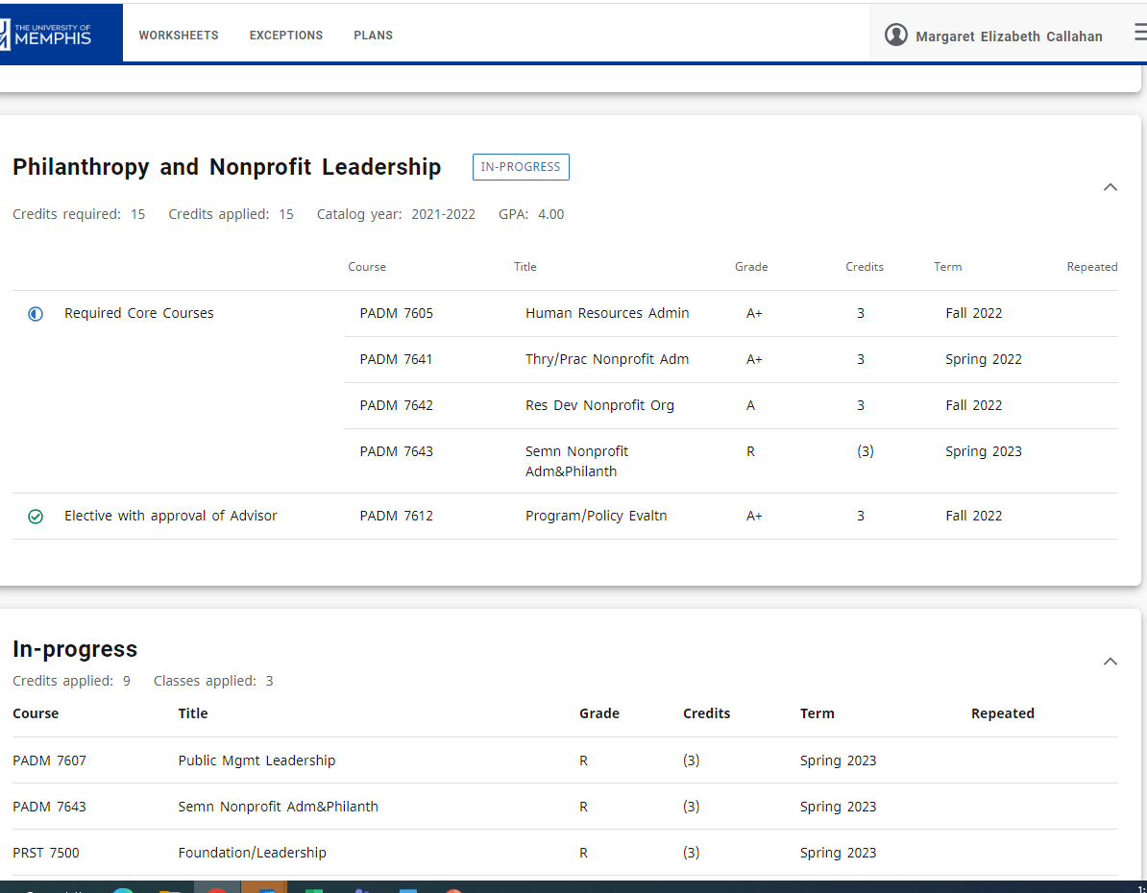
UMDegree – Ready to Graduate
You will see the Certificate and all the courses required.
You will see the course you are registered to take.

Slide 24
Degree Certification Process
Walk Across the Stage
Grades are Posted – usually a few days after graduation
I certify the degrees – goal is to complete most within two weeks. Transcripts are automatically updated with the graduation date. Thesis and Dissertation titles will also be added to the transcript.
PhD students will receive the diplomas at Graduation – everyone else waits a few months.
Degrees need to be certified within about 8 weeks – there is some flexibility.

Slide 25
Thesis and Dissertation Credits
A total of all the credits will be added to the last semester on the transcripts.
In Progress grades will remain in earlier terms. An SA in the last term indicates the paper has been approved by the program.
This is another step in the certification process.

Slide 26
I am here to help …
Please feel free to contact me if you have questions:
mcllahan@memphis.edu
901-678-3560 – office
901-443-1194 – google voicemail

