Slide 1

ACADEMIC ADVISING
Part-Time Rising 2Ls
Associate Dean Jodi Wilson
jlwlson2@memphis.edu

Slide 2
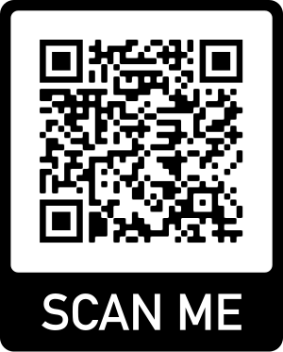

STUDENT ADVISING
http://bit.ly/StudentAdvising

Slide 3

Details, Details
Academic Advising Worksheet
Academic Regulations
(Esp. AR 5, 6, 10 & 16)
Registration Memo
Course Catalog
Fall 2023
Course List, Course Grid & Exam Schedule
Summer 2023 Schedule & Spring 2024 Tentative Course List

Slide 4
Graduation Requirements
40 Hours of Pro Bono Service
2.0 GPA or Better
90 or More Credit Hours
Required courses
Advanced writing requirement course
Experiential learning requirement courses
Electives

Slide 5
Required Courses - PT
2L
3L or 4L
Business Organizations (3)
Evidence (4)
Con Law (4)
4L
Bar Prep (3) – Spring Only
Commercial Law (4)
Professional Responsibility (2)
Decedents’ Estates (3)
OR Sales (3) and Secured Transactions (3)
Criminal Procedure I (3)
Property I & II (6)
Contracts I & II (5)
All Tested on the Bar or MPRE.

Slide 6
Advanced Writing Requirement
Eligible Courses – Choose 1
Seminars
C or better (on paper and in course)
Law Review Notes
Required Grade
Timing
After completion of FT 1L Curriculum

Slide 7
Experiential Learning Requirement
Eligible Courses – Choose 6 CHs
C or better/Satisfactory or better
Relevant Requirements
Simulation Courses (e.g., Trial Advocacy)
Clinics
Externships
Relevant Limitations
10 clinic hours MAX
3 externship/clinic courses MAX
1 clinic or externship at a time
Externship Eligibility: 28 hours completed before beginning externship
Clinic Eligibility: 45 hours completed before beginning clinic
At least 1 clinic or externship

Slide 8
General Limitations
MAX Ungraded (Pass/Fail) Hours
MAX Hours Per Semester
PT: 11 hours
12 hours
MIN Hours Per Semester
PT: 8 hours

Slide 9
Registration
Timeline
Veterans: April 3, 7 a.m.
43+ Attempted Credit Hours (“ACH”): April 11, 8 a.m.
42-15 ACH: April 13, 8 a.m.
0-14 ACH: April 14, 8 a.m.
ACH do not include the hours currently in-progress.

