Slide 1

RE-AIM Public Health IDEAS Hackathon Information Session
Learn More About How to Innovate Solutions for Healthier Communities

Slide 2


The University of Memphis
School of Public Health
2024-2025 RE-AIM Public Health IDEAS Hackathon
Innovate for Health:
Empower Youth for Digital Health and Well-Being

Slide 3
What is the RE-AIM Public Heath IDEAS Hackathon?
The University of Memphis' 2024-2025 Public Health Hackathon invites high school and college students to address global health challenges through innovative solutions.
Aligned with UN Sustainable Development Goal 3 (SDG 3), this event emphasizes ensuring healthy lives and promoting well-being for all ages. Participants will gain valuable skills, collaborate with peers and mentors, and compete to create impactful public health projects and creative solutions in digital health and well-being.
This Year's Theme:
Innovate for Health – Empower Youth for Digital Health and Well-Being
This is your chance to tackle real-world health challenges and drive impactful change!

Slide 4


What Is A Hackathon?
A hackathon is a fast-paced, collaborative competition event where students like you come together to brainstorm, design, and build creative solutions to real-world challenges.
Picture yourself working in a team, learning new skills, and having access to mentors, tech tools, and a space buzzing with creativity. You’ll have the chance to pitch your ideas, get feedback from experts, and maybe even win some cool prizes. It’s the perfect opportunity to bring your passion for making a difference to life, all while having fun and meeting new people.

Slide 5





Why Should You Join?
Join our Hackathon: Innovate for Health: Empower Youth for Digital Health and Well-Being ​​
Imagine this: A room buzzing with energy, teams of students working to transform an idea into something real. That’s the vibe of a hackathon, and it’s your chance to dive in!​
Supercharge Your Skills: Work with top industry mentors and sharpen your skills in problem-solving, teamwork, digital innovation, and pitching. These are the skills that stand out on your resume, college applications, and portfolio!
Get Noticed by Colleges & Employers: Show that you can tackle real-world challenges and create solutions that improve lives. This experience can be your golden ticket to standing out!
Build Your Portfolio: Add a project that proves you can turn ideas into reality—perfect for impressing admissions teams and future employers!
Awards & Recognition: Official Certificate of Participation: Perfect for showcasing your achievements. Exclusive Public Health Swag & Souvenirs: Take home some cool gear as a reminder of your impact.
Spotlight Opportunity: Top 5-10 ideas will be featured on the School of Public Health website, social media, and newsletter. Your work could inspire thousands!
High school and college students, this is your moment. Innovate for Health is more than just a competition; it’s an opportunity to address real-world health challenges, from mental well-being to digital health tools. You’ll team up with peers, push your creativity to the limit, and see your ideas come to life! ​​
This is your chance to make a difference, stand out, and have a blast! Be bold, be creative, and build the future of digital health with us. ​

Slide 6

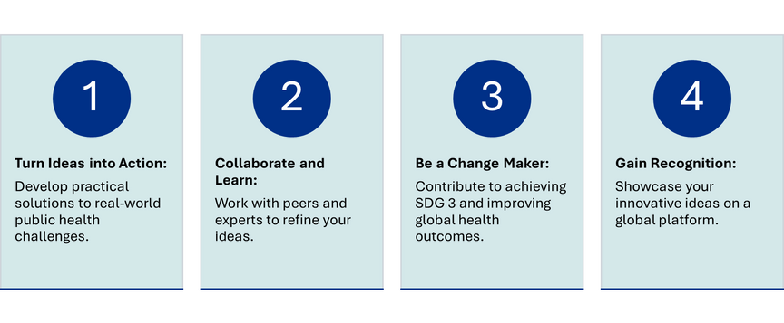


Join Us This Year
Why Participate?
How to Participate
Innovate for Health
Join Us in Creating a Healthier Future
We invite high school students (grades 9-12) and University Students to participate in this transformative experience. Whether you’re passionate about improving mental health, tackling global pandemics, or promoting universal health coverage, this hackathon is your platform to turn ideas into reality.
Ready to Make an Impact? Here’s How to Join!
Step-by-Step Guide:
  Register: Secure your spot in the hackathon
  Prepare: Sign up to attend our supplemental workshops to refine your ideas and improve your skills.
  Apply and Submit: Develop your solution, submit it in a 500-word abstract, send in your application, and pitch your idea to our esteemed panel of judges.
Who Can Participate?
High School Students:
Grades 9-12, with an interest in public health and solving health challenges.
University Students:
Students in all fields and majors

Slide 7
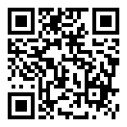
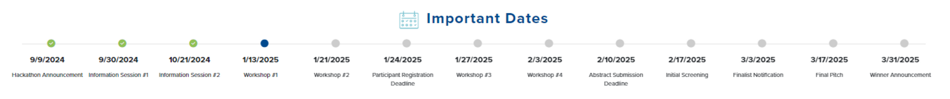
What Will You Learn?
Innovate
Innovate Solutions: Develop creative, evidence-based solutions to pressing public health issues.
Gain
Gain Skills: Enhance your problem-solving, project design, and pitching abilities through hands-on workshops.
Collaborate
Collaborate: Work with peers and mentors to refine your ideas and make a real-world impact.
Accelerate
Accelerate Impact: Quickly transform your ideas into actionable projects that can create positive change.
STEP 1:
Register Your Team and Reserve Your Spot Today
Go to https://forms.office.com/r/U9MNPKiGkJ or scan the QR Code to register yourself or your team and reserve a spot in the Hackathon!

Slide 8
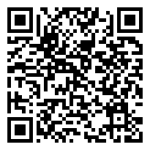
  Participants will engage in four hands-on workshops designed to guide them from identifying public health problems to developing and pitching innovative solutions.
Sign up here at https://www.memphis.edu/publichealth/initiatives/hackathon-2024-2025.php#workshops
  Problem Identification
  Idea Generation
  Project Design
  Pitching
STEP 2: Join Us in Our Supplemental Public Health Innovation Design Workshops

Slide 9
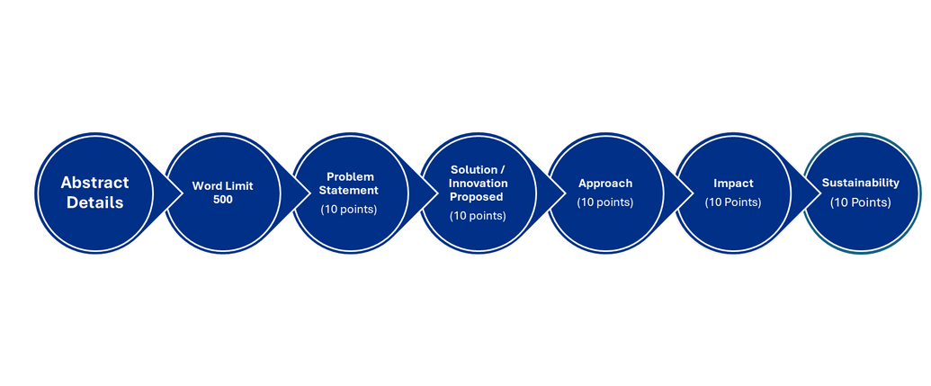
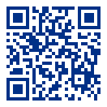

What Next?
We invite multisector, multi-institutional, cross-country participation in this innovative initiative to sensitize youth about the importance of public health and create a community of learners and leaders in public health.
STEP 3:
Submit Your Abstract and Application
Abstract Details
Word limit: 500
  Problem statement (10 points)
    Highlight topic and the public health problem it addresses
      Background
      Objective
      Significance and Relevance
  Solution/Innovation proposed (10 points)
  Approach (10 points)
    Describe how you plan to address this problem
  Impact: (10 Points)
    How would you assess?
  Sustainability: (10 Points)
    How will you propose the sustainability of the solution? (10 Points)
Apply Now
  Go to https://forms.office.com/r/sX97cdNh5Tor scan the QR Code to send in your abstract and submit the Hackathon Application.​
  Apply and submit your abstract entry for consideration.​

Slide 10
Public Health Innovation Design Workshops
  Participants will engage in four hands-on workshops designed to guide them from identifying public health problems to developing and pitching innovative solutions.
  Problem Identification: Pinpoint critical public health issues
  Idea Generation: Develop creative and feasible solutions
  Project Design: Turn ideas into actionable projects
  Pitching: Refine your presentation skills and pitch your ideas to an expert panel

Slide 11

Design Principles
Notice
Conduct secondary research to determine industry trends
Identify other relevant demographic, political, social, economic, or technological trends
Identify your key stakeholders
Identify your positionality
Empathize
Develop empathy for a particular group of people through interviews and rapport building
Define
Synthesize your research and develop a visualization of what is going on
Identify a few key needs/insights/issues that a future scenario will have to address
Define an opportunity for innovation
Ideate
Generate a wide range of ideas of what is possible
Explore different parts of the experience that could be improved
Create a number of provocative ideas
Select the most promising ideas
Prototype
Understanding our assumptions
Prototype different types of ideas
Get feedback on your ideas
Implement
Tell a compelling story about your idea and the impact it will have on people
Articulate your value proposition
Reflect
Identify next steps for implementing your ideas
Anticipate impact
Observe how people experience daily life or currently address problems
Notes:
Speaker Notes:
Design is all about identifying opportunities and creating value.
It involves taking risks and being innovative to bring new ideas to life.
In the context of public health, this means developing new solutions to improve health outcomes and address health disparities.
More on Design:
Design is a creative and systematic process of envisioning, planning, and producing a solution, product, or experience with a specific purpose or set of goals in mind. It involves identifying problems, understanding user needs, generating ideas, and iterating on prototypes to develop a functional and aesthetically pleasing outcome. In broader terms, design can refer to the plan or blueprint that guides the creation of something new, whether it’s a physical object, a digital interface, a process, or a service.
Key aspects of design include:
Problem-Solving: Design aims to address a specific problem or need, finding effective and innovative ways to meet those requirements.
Creativity: Design relies heavily on creative thinking to generate new ideas and explore multiple possibilities.
User-Centeredness: Good design is often user-centered, meaning it considers the needs, behaviors, and experiences of the people who will use the product or service.
Functionality: While aesthetics are important, the primary goal of design is to ensure that the final product works well and fulfills its intended purpose.
Iteration: Design is an iterative process, where ideas are tested, refined, and improved based on feedback and testing.
In summary, design is both a process and a mindset focused on creating solutions that are functional, efficient, and aligned with user needs.
Reference:
Norman, D. A. (2013). The design of everyday things (Revised and expanded edition). Basic Books.

Slide 12

Public Health Innovation Design Process
Identify Public Health Problems
Research and Analysis
Ideation
Prototype
Implementation
Pitch

Slide 13

Identifying Public Health Problems
  Look for gaps in current healthcare services.
  Consider the needs of underserved populations.
  Use data to identify and prioritize issues.
Notes:
Speaker Notes:
The first step in developing a public health venture is identifying a specific problem.
Look for gaps in current healthcare services where needs are not being met.
Consider the unique needs of underserved populations who may lack access to traditional healthcare.
Use data to identify and prioritize the most pressing public health issues in your community.
Public health problems are defined as issues that adversely affect the health of communities. Common examples include infectious diseases like COVID-19, chronic conditions like diabetes, and environmental hazards such as pollution
Identifying public health needs involves assessing the health status of a population, often through community assessments and health data. Engaging with the community is crucial for gathering accurate data and building trust
Activity: Practice identifying public health problems and creating problem statements
References
World Health Organization. (2021). Health topics. Retrieved from WHO
Centers for Disease Control and Prevention. (2018). Community health assessment. Retrieved from CDC

Slide 14
Research and Analysis
Conduct qualitative and quantitative research
Understand root causes and contributing factors
Review existing interventions and best practices
Notes:
Speaker’s Notes:
Research and analysis are essential to understand the problem deeply.
This includes both qualitative methods, like interviews and focus groups, and quantitative data analysis.
Reviewing existing interventions helps identify what works and where there are gaps.
Equip students with basic research skills and insights to inform their solutions.
Activities:
Research Techniques Overview: Introduce basic research methods such as surveys, interviews, and observations. Provide examples and templates for each.
Group Research Activity: Assign each group a research method to gather information about their problem. Encourage them to use online resources or interviews with peers.
Sharing Insights: Have each group present their findings and discuss how these insights influence their understanding of the problem.
Reference:
Sanders, E. B.-N., & Stappers, P. J. (2014). Probes, toolkits and prototypes: Three approaches to making in codesigning. CoDesign, 10(1), 5-14.

Slide 15
Ideation
Generate a wide range of ideas
Encourage creativity and diverse perspectives
Use techniques like brainstorming and mind mapping
Notes:
Speaker’s Notes:
During ideation, we generate a wide range of ideas without judgment.
Techniques like brainstorming and mind mapping are useful here.
The goal is to explore diverse perspectives and consider all possible solutions, no matter how unconventional they may seem at first.
Encourage students to generate and explore multiple solutions.
Activities:
Brainstorming Session: Teach brainstorming techniques like "Crazy 8s" (sketching eight ideas in eight minutes) and "Mind Mapping." Emphasize quantity over quality initially.
Idea Selection: Guide groups in evaluating their ideas using criteria such as feasibility, impact, and innovation. Use tools like "Dot Voting" to prioritize ideas.
Activity: Brainstorming solutions
Encourage wild ideas and build on each other’s suggestions.
Use sticky notes to jot down ideas and place them on a board.
Discussion: Narrow down to the most feasible and impactful solutions.
Wrap up by going through prototyping, feedback, implementation, reflect as theories
Reference:
Kolko, J. (2015). Exposing the magic of design: A practitioner's guide to the methods and theory of synthesis. Oxford University Press.

Slide 16
What is Prototyping?
Prototyping is the process of creating a preliminary model of a product, service, or experience to test and refine ideas.
Allows designers to explore concepts, solve problems, and gather feedback before final production
Identifies potential issues early
Ensures the final solution meets user needs
Notes:
Speaker Notes:
Prototyping is a key step in the design process, providing a tangible representation of ideas.
It enables us to experiment, iterate, and improve our designs through direct user feedback.
Whether we're working on a product, service, or experience, prototyping helps us visualize and refine our concepts in a cost-effective manner.
Reference:
Dam, R. F., & Siang, T. Y. (2020). What is prototyping?. Interaction Design Foundation. Retrieved from https://www.interaction-design.org/literature/article/what-is-prototyping

Slide 17

Prototyping for Services, Products, and Experiences
Service
Service Prototyping: Simulates service delivery, testing interactions and processes.
Product
Product Prototyping: Focuses on creating physical models to test usability and functionality.
Experience
Experience Prototyping: Combines elements to test the overall user journey.
Notes:
Speaker Notes:
Prototyping isn't just for physical products—it's equally important for services and experiences.
Service prototyping helps us understand and improve the delivery of a service by simulating the interactions between users and the service.
Product prototyping allows us to test the physical aspects of a design, ensuring it's functional and user-friendly.
Experience prototyping integrates various elements to simulate the entire user journey, helping us refine the overall experience.
Reference:
Blomkvist, J., Holmlid, S., & Segelström, F. (2010). Service prototyping according to service design practitioners. In Proceedings of the 2nd Service Design and Service Innovation Conference (pp. 1-11).

Slide 18
From Prototype to Implementation
Final Refinements: Use insights from the final prototype to make necessary adjustments.
Planning: Develop a detailed plan for production or launch.
Execution: Move from the prototype stage to full implementation, ensuring quality and consistency.
Notes:
Speaker Notes:
Once we've iterated on our prototypes and gathered sufficient feedback, it's time to move towards implementation.
The final prototype should inform any last adjustments before we enter the production or launch phase.
At this stage, detailed planning is crucial to ensure that the transition from prototype to final product or service is smooth and successful.
Reference:
Curedale, R. (2016). Design thinking: Process and methods manual. Design Community College Inc.

Slide 19







Give Your Final Pitch For Judging​
Give Your Final Pitch For Judging​
Find Opportunities to Take New Ideas and Create Value

Slide 20
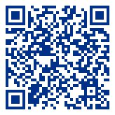
2024-2025 RE-Aim Public Health
IDEAS Hackathon
For more information and to apply, visit the 2024-2025 Public Health Hackathon webpage at https://www.memphis.edu/publichealth/initiatives/hackathon-2024-2025.php
If you have any questions, email Michelle Jeu, MPH, Project Manager, RE-AIM Public Health IDEAS Initiatives, The University of Memphis School of Public Health at majeu@memphis.edu.

